Slide 1
Comparative vibration Test (Junker Test)

Slide 2
Comparative Junker Test
1. Description of the test
Vibration tests (Junker test) for evaluating locking performance of Original SCHNORR® safety washers M8 made of carbon steel/spring steel (DIN EN 10132-4) with zinc-flake coating as well as tests of a competitors products for performance comparison
2. Reference standards of the test
The tests were based on the following reference standards:
- DIN 25201-4:2010-03 design guide for railway vehicles and their components – Bolted joints – Part 4: Securing of bolting joints – Appendix B
- DIN 65151:2002-08 Aerospace series – Dynamic testing of the locking characteristics of fasteners under transverse loading conditions (vibration test)
3. Test parameters and test implementation
Setting trials: Before testing, the setting trials were implemented according to the requirements of point B.3 of the DIN 25201-4. Flat washers according to DIN EN ISO 7093-1 were used as counter surface.
Vibration frequency used in tests: The frequency of the traverse displacements used was 12,5 Hz.
Preload and lubrication: The tested sets were tightened by wrench until the required preload corresponding to table B.1 of the DIN 25201-4 was reached. For the objects made of carbon/spring steel (DIN EN 10132-4) screws M8 in quality 8.8 were used, with a preload of Fv_{v} of 9,1 kN. The tested sets were lubricated according to part B.5.2 of the DIN 25201-4 with lubrication-oil HD 30.

Slide 3
Overview of the tested bolt locking systems
Product | Surface
Original SCHNORR® Safety Washers | Zinc-Flake
Wedge-Locking Washers | Zinc-Flake
Split Lock Washer | Mechanically galvanized
Detent-Eedged Washer | Zinc-Flake
Ripped Washer | Zinc-Flake
Spring Washer (DIN 137 B) | Mechanically galvanized

Slide 4
Original SCHNORR® Safety Washer

Slide 5
Overview competing products
Wedge-Locking Washers
Split Lock Washers
Detent-Edge Washers
Ripped Washers
Spring Washer
(DIN 137 B)

Slide 6
Vibration Test result Original SCHNORR® safety washers (Art.-No. 401070)

Slide 7
Prints of the Original SCHNORR® Safety Washers 401070
Prints are very well marked on the counter piece, which guarantees a high locking performance of the bolt

Slide 8
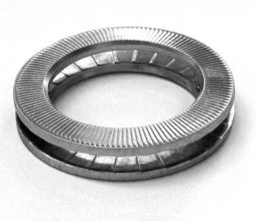
Vibration Test results Comparison of Original SCHNORR® Safety Washers vs. Wedge-Locking Washer

Slide 9
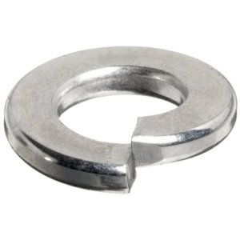
Vibration Test results Comparison of Original SCHNORR® Safety Washers vs. Split Lock Washer

Slide 10
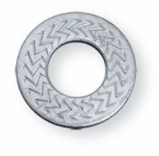
Vibration Test results Comparison of Original SCHNORR® Safety Washers vs. Detent-Edged Washer

Slide 11
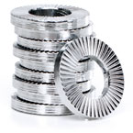
Vibration Test results Comparison of Original SCHNORR® Safety Washers vs. Ripped Washer

Slide 12
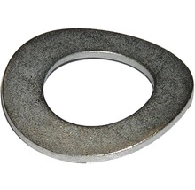
Vibration Test results Comparison of Original SCHNORR® Safety Washers vs. Spring Washer

Slide 13
Comparison Original SCHNORR® safety washers and misc. bolt locking systems

Slide 14
Résumé
The Junker test clearly shows a superior locking performance of the Original Schnorr® safety washers in term of number of cycles lasted and in term of residual spring load after 2000 cycles in comparison to split lock washers, detent-edged washer, ripped washers and spring washers (DIN 137 B)
The test also shows that Original Schnorr® safety washers have the same locking performance as all kinds of multifunctional wedge-locking washers just like Nord-Lock, Twin-Lock and Heico-Lock.

